Slide 1
Support tourists in booking hotels
IBM PROFESSIONAL DATA SCIENCE CERTIFICATE
(Capstone Project)
PORIA SIMA
January 2021

Slide 2
Introduction
Tourism is a popular industry to develop local economics in the world. It provides governments with several benefits, including boosting the economy's revenue, investing thousands of jobs, and evolving countries' infrastructures. Hence, governments are enthusiastic about attracting more and more tourists to visit their country, which requires presenting safe and advanced facilities.
In 2019, it was estimated that the number of international tourist arrivals worldwide would reach approximately 1.46 billion while there were 35.4 million tourist arrivals in hotels in Paris. It is one of the most visited cities in Europe attracts millions of visitors from abroad or France.
Lan Xue and Yi Zhang have investigated the effect of distance on tourist behavior. The study explored tourists' behavioral patterns in three groups: long-haul tourists, short-haul tourists, and local visitors who visited Suzhou, China, from April 2012 to October 2013. It results in different motivations behind trips.
1

Slide 3
Introduction
Visitors and motivations
Local visitors
  keen on relaxation and shopping
  interested in theme hotels and hostels
  less enthusiastic about local foods
Short-haul visitors
  mixed relaxation with sightseeing
  visit cultural heritage, famous sites, and favored high-end hotels and restaurants
Long-haul visitors
  principally visited for sightseeing and seeking product features and qualities
  consider their travel a once-in-a-lifetime trip
(Lan Xue and Yi Zhang, 2020)
2

Slide 4
Introduction
According to several trips' motivations, book a hotel based on the intention helps tourists save time and assets. Short-haul tourists enjoy high-end hotels in a neighborhood close to top-ranked restaurants, while long-haul tourists are keen to accommodate nearby museums and attractions.
So, the question is which hotel and which neighborhood satisfy visitors' various motivations?
This article focused on supporting visitors to book the fittest hotel in Paris by clustering neighborhoods based on time distance to attractions, restaurants, and shopping malls. It satisfies visitors to choose the best neighborhood and makes stakeholders like the government, restaurant managers, and hotel managers alliances to invest in a particular region.
3

Slide 5
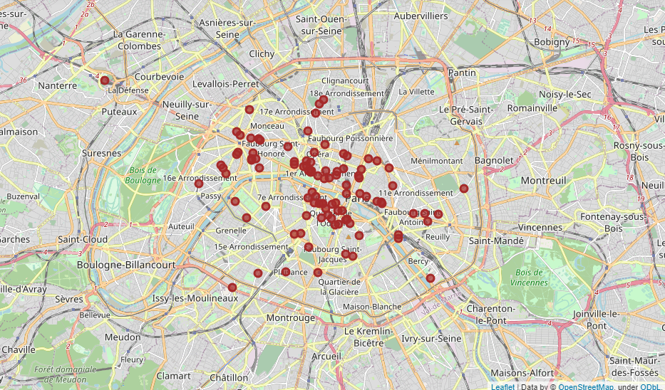
Data Collection
Introduction
This article considers ninety-nine hotels in the capital of France.
Foursquare API extracts hotels locating less than twenty kilometers from Paris.
The API response provides Hotels' attributes such as name, rate, and geographical coordinates.
4

Slide 6
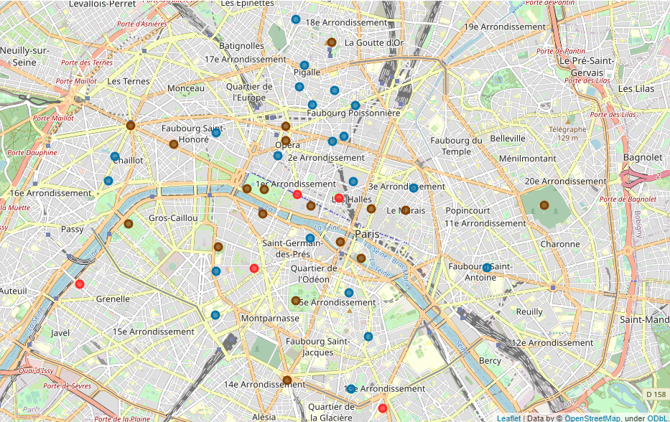
Data Collection
Venues
Tourist Attractions
  Nineteen top tourist attractions ranked by Tripadvisor website
Restaurants
  Top twenty restaurants ranked by Tripadvisor website
Shopping Malls
  Top five shopping malls ranked by France-hotel-guide website
5

Slide 7
Data Collection
Methodology
Step 1: Calculating the distance between hotels and attractive venues
  time durations to charming venues are extracted per second for each hotel in two modes (driving and public transit.)
Step 2: Data Scaling
  time duration data is scaled by the Standard Scaler method to be prepared for clustering.
Step 3: Optimize number of clusters
  The Elbow method is utilized in this article to calculate the number of neighborhoods.
Step 4: Apply K-mean Clustering algorithm
  By Applying the K-mean clustering algorithm into data, hotels are investigated by similarity in features
6

Slide 8
Methodology
Results and Discussion
The article attempts to aiding tourists in getting the most appropriate hotel by considering their interests. Hence, Foursquare API's list of ninety-nine hotels in Paris is discovered to recommend.
7

Slide 9
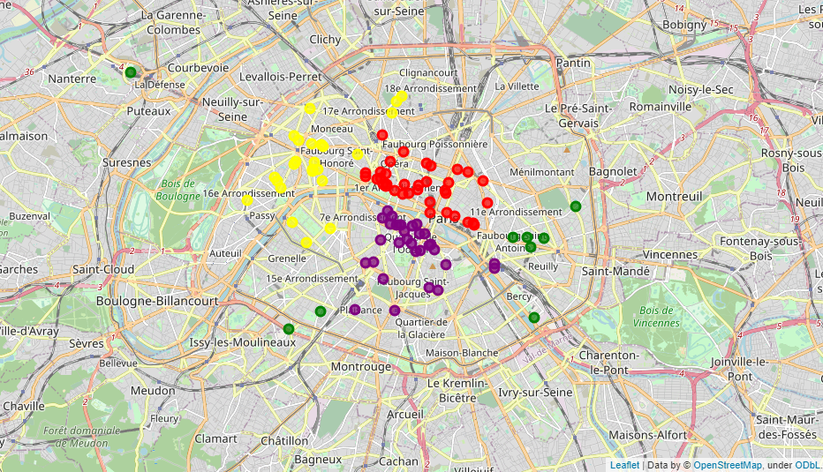
Results and Discussion
Hotels are segmented into four different clusters has been performed by calculating time durations from each hotel to venues that bring tourists' trips.
Using the following result as guidance in booking accommodation makes travelers more confident about their hotel's location regardless of other convenient amenities.
8

Slide 10
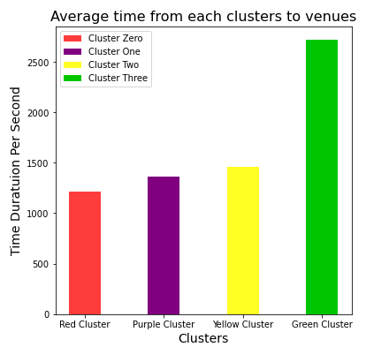
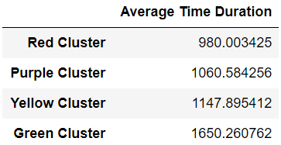
Results and Discussion
Clusters have been sorted by time distance to all venues. It seems that the red cluster is the best choice for visitors, while it is not sufficiently precise yet.
9

Slide 11
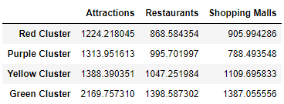
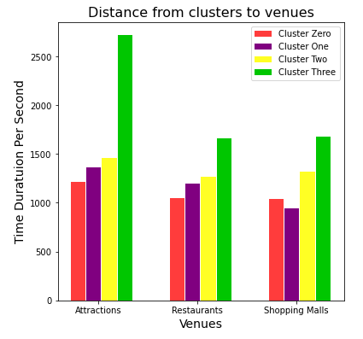
Results and Discussion
Clusters have been sorted by time distance to all venues. It seems that the red cluster is the best choice for visitors, while it is not sufficiently precise yet.
Accordingly, it is necessary to compare time durations from clusters to venues of travelers’ targets. It would result in excellent guidance to recommend hotels.
10

Slide 12
Results and Discussion
Hotels in the red cluster have been immensely recommended to travelers who travel to Paris for a short time to visit the city's aesthetic heritage, have leisure and release tensions. As this group of travelers are keen to access popular restaurants, grand shopping malls, and popular galleries and museums, the red cluster is the most suitable selection because of the closest distance to tourist attractions and restaurants and a reasonable distance shopping malls.
11

Slide 13
Results and Discussion
Likewise, the red points are also the most suitable options for long-haul travelers who are enthusiastic about cultures, history, local foods, features, and qualities, while it is not the perfect decision for local visitors profoundly eager to spend more in shopping malls and relaxations.
12

Slide 14
Results and Discussion
Local visitors who travel for leisure are more enthusiastic about the outlets, shopping centers and top restaurants and cafes. Furthermore, they are less interested in museums and tourist attractions they have visited before for times, so it is required to recommend hotels close to the venues in the category of shopping malls and restaurants. Hence, the fittest cluster to this group is purple hotels located approximately thirteen minutes far from shopping malls and fifteen minutes on average to most top restaurants in Paris.
13

Slide 15
Results and Discussion
The Green segment might be the appropriate opportunity for business trips, but it can not be an excellent tourist arrangement. Hotels in this cluster are located almost thirty-five minutes far from tourist attractions and popular facilities, leading to wasting visitors' assets. In comparison, the yellow cluster is more reasonable, with an average of less than twenty-five minutes far from attractions, restaurants, and shopping malls.
14

Slide 16
Results and Discussion
Conclusion
By recommendation of a list of fittest hotels to visitors, they could concentrate on other favor features for their accommodation, regardless of location. Accordingly, it is significantly beneficial for visitors who confront a city they have never been visited and are not familiar with its public transportation, attractions, venues' locations, and directions.
Furthermore, by determining clusters, stakeholders investigate boroughs with the most demands from visitors to invest in conducting hotels, restaurants, theme parks, or other related tourists.
Finally, it would be more useful if tourist leader websites such as Tripadvisor and booking.com consider this location clustering in their hotel ranking, providing tourists with more clear choices.
15

Slide 17
Thank you

